Slide 1
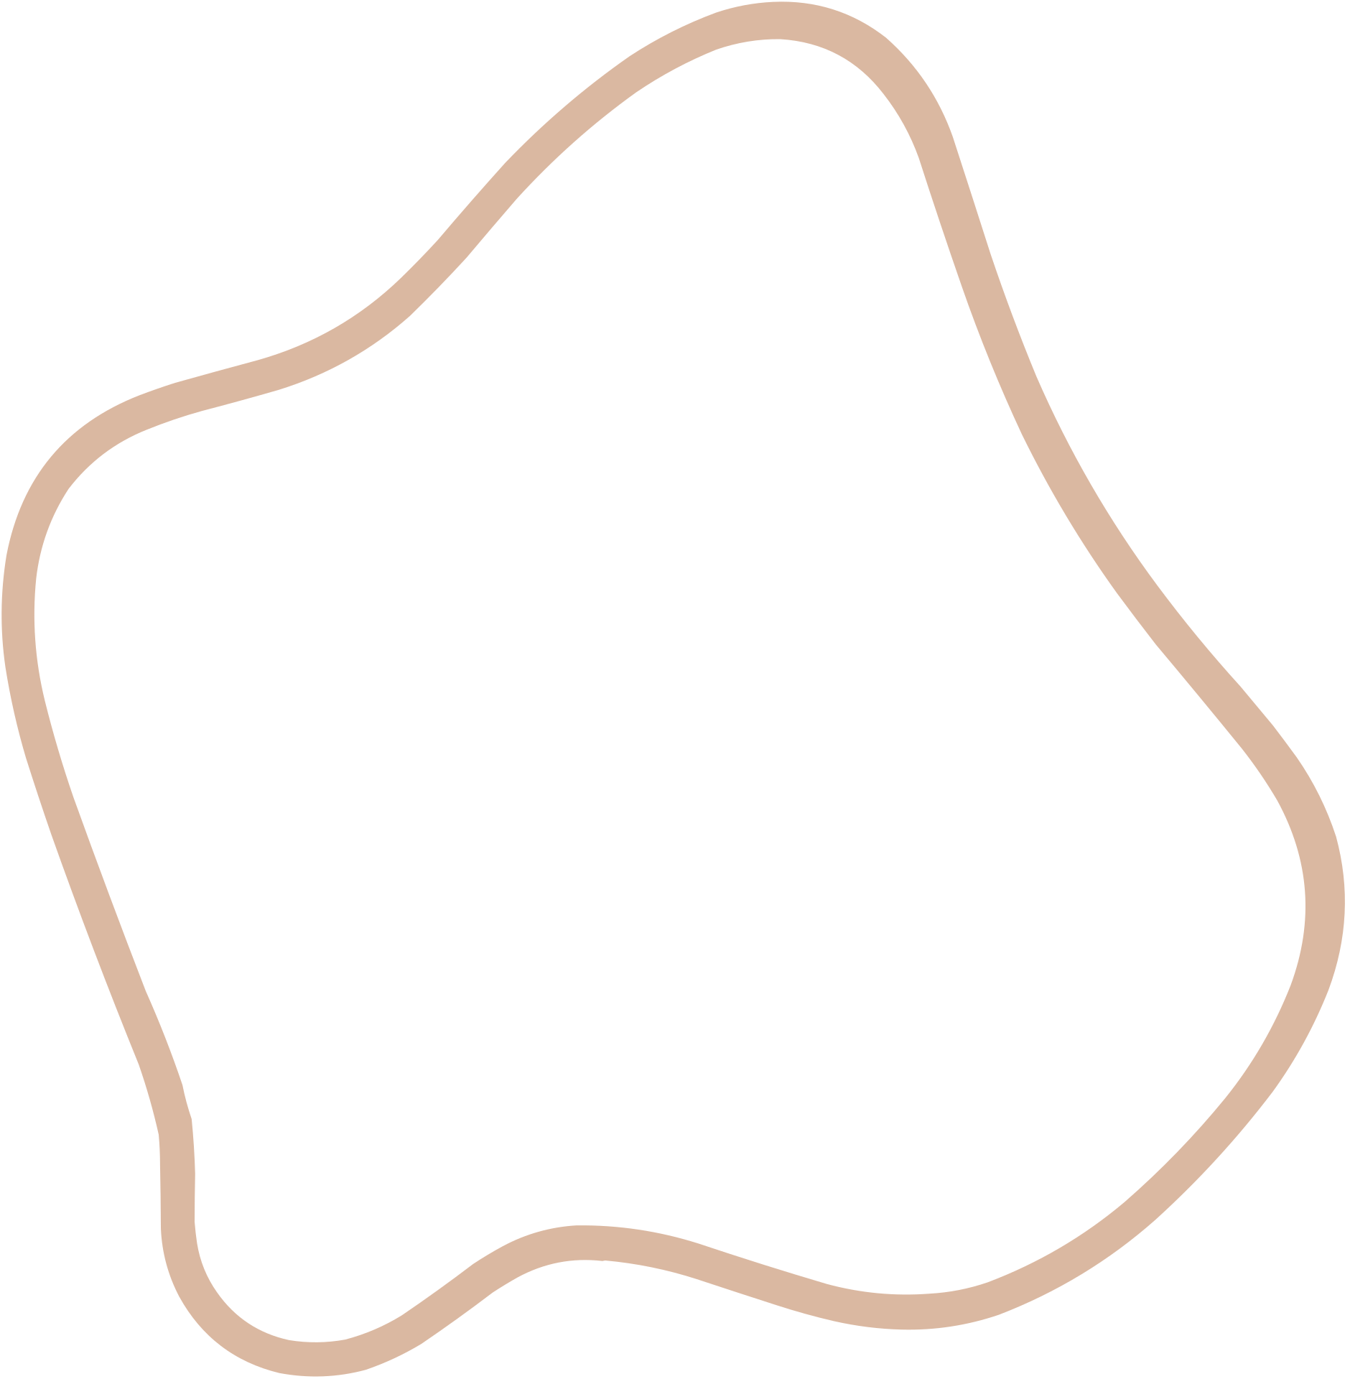
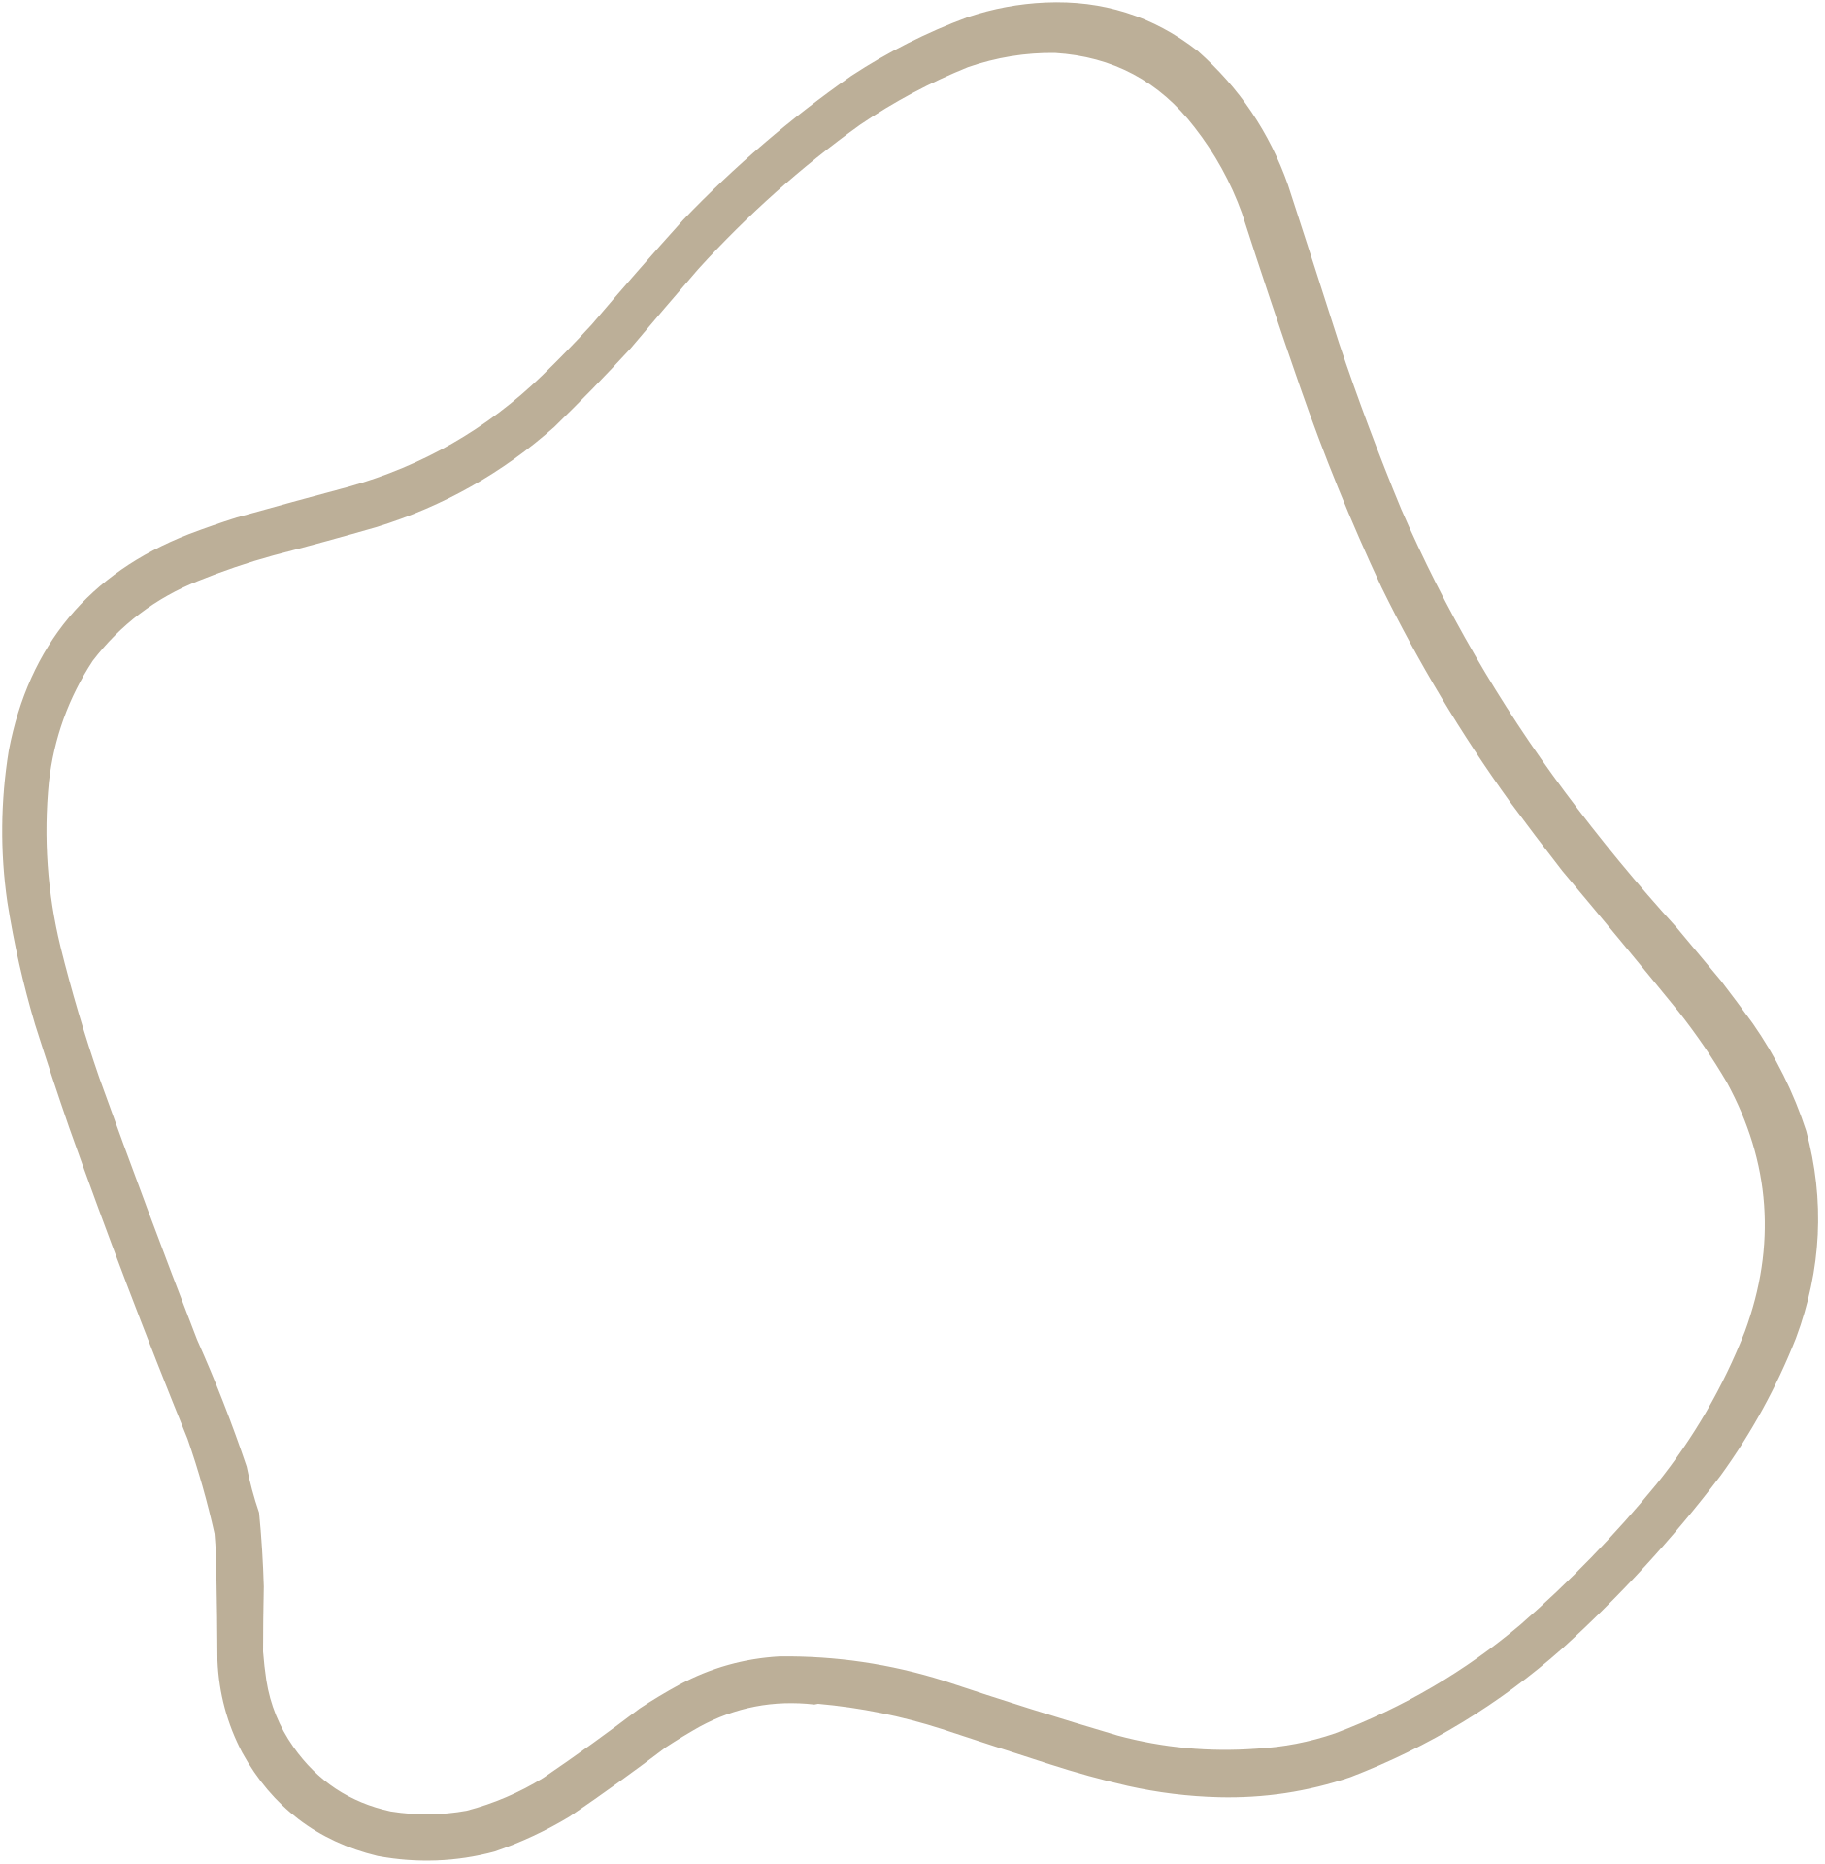
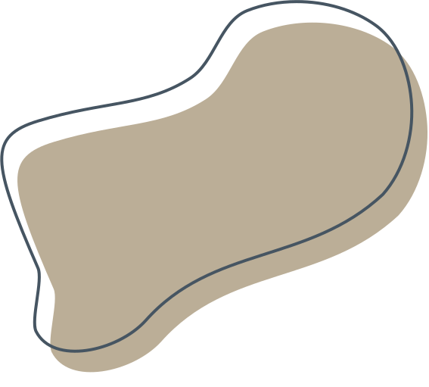
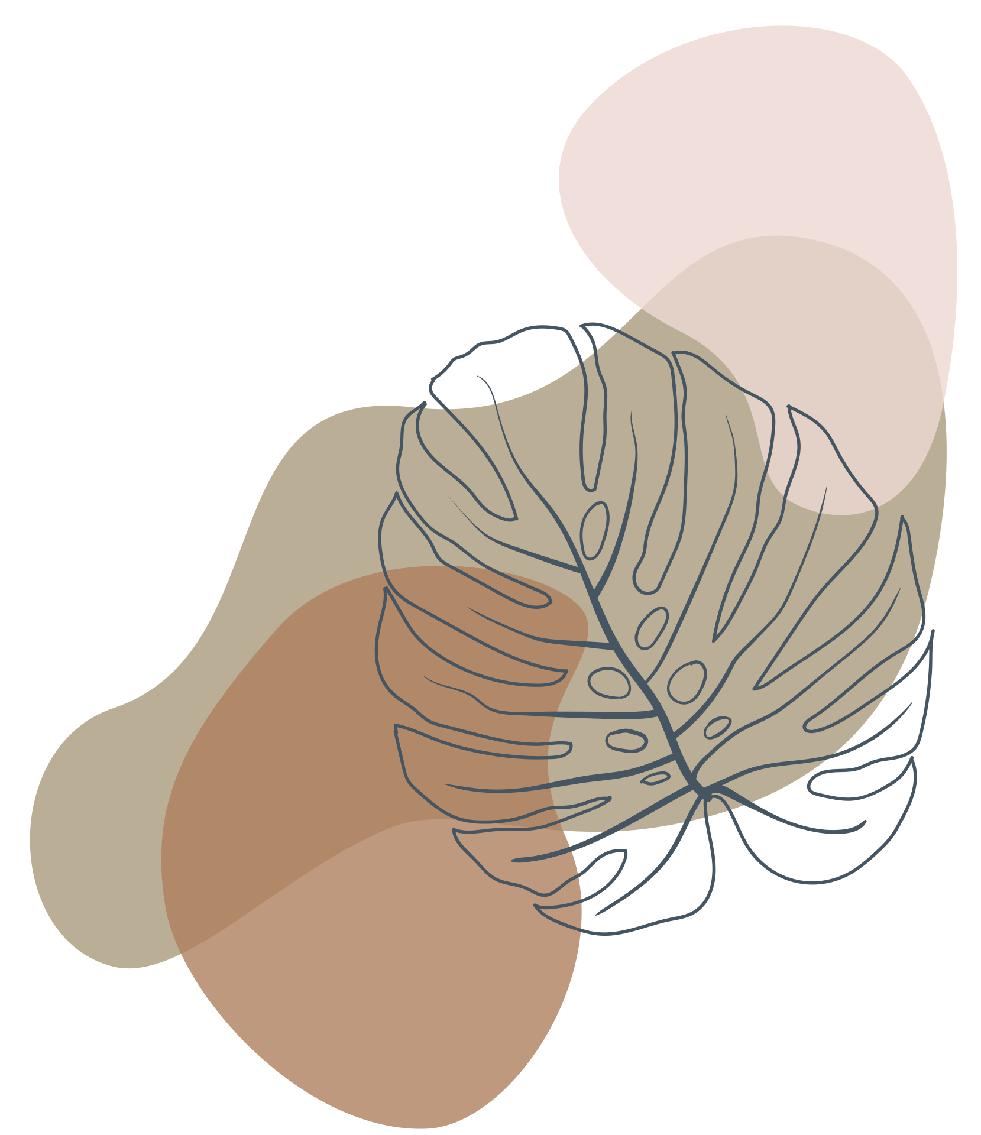
Autonomous Robot with Obstacle Avoidance and Auto-Parking
Embedded Systems

Slide 2
Team Members
Name | ID | Department
Alia Medhat | 20221440735 | AI
Aya Abdelmoniem | 20221462478 | AI
Doaa Samir | 2103114 | AI
Malak Mahmoud Aref | 20221445867 | AI
Nouran Mohamed | 20221321932 | AI

Slide 3
Table of
Contents
Introduction
Components
Benefits
Applications
flowchart
Videos
Alexandria University

Slide 4

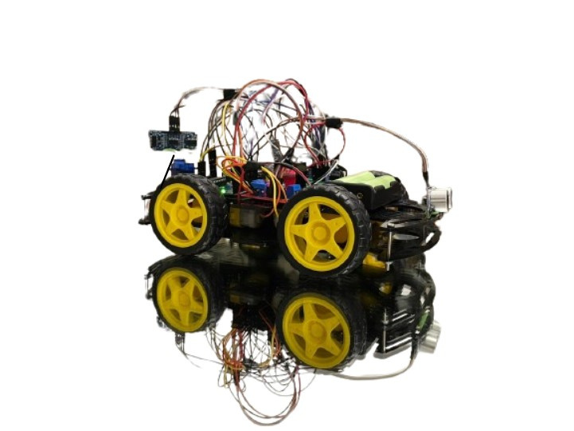
Introduction
Autonomous robots with obstacle avoidance and auto-parking capabilities represent a significant advancement in robotics technology. These robots are designed to navigate through environments autonomously, detecting obstacles in their path and avoiding collisions while also being able to park themselves without human intervention.
Alexandria University

Slide 5

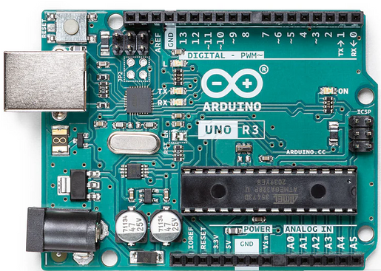
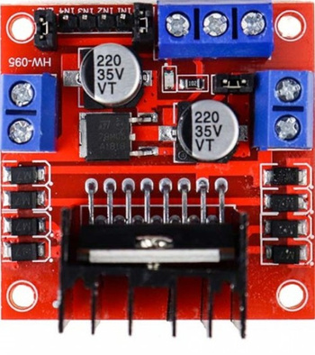
Components
Arduino Uno
L298N H-bridge
Arduino Uno is an open-source microcontroller board based on the processor ATmega328P. There are 14 digital I/O pins, 6 analog inputs, a USB connection, a power jack, an ICSP header, and a reset button.
It controls the speed and direction of the DC motors. It contains power supply, digital input pins, and DC Motor A&B connection.
Alexandria University

Slide 6
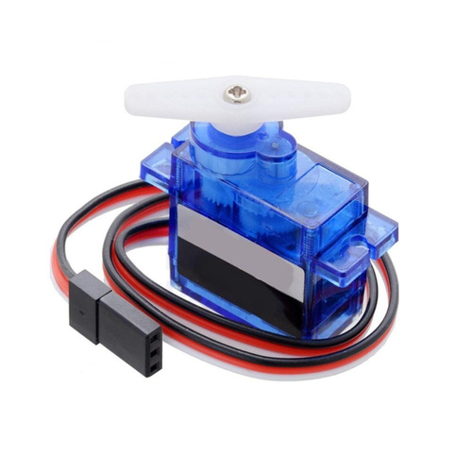
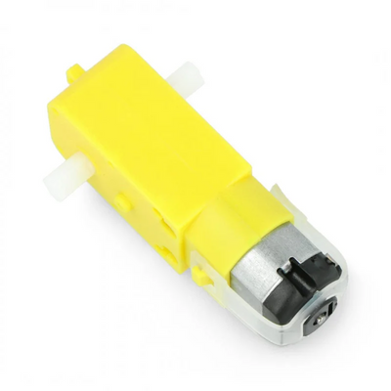
Components
Servo motor
DC Gear Motors
It is a precise control device that helps in controlling the position, velocity, and acceleration of mechanical systems. It consists of a motor connected to a sensor for feedback on position and a controller.
It is to provide controlled movement and power to machines or devices. It uses electrical energy to spin gears, which in turn control the speed and torque (rotational force) of the motor.
Alexandria University

Slide 7
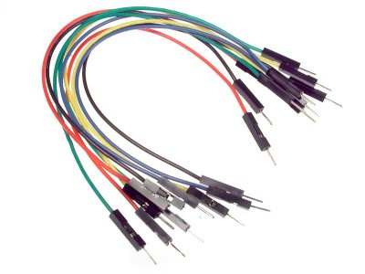
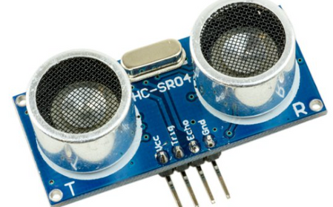
Components
Jumper Wires
HC-SR04 ultrasonic sensor
It is used for making connections between items on the breadboard and in Arduino's header pins. There are 3 types: male-to-male, male-to-female, and female-to-female.
It is a sensor used for detecting the distance to an object using sound waves. It consists of two transducers: transmitter and receiver. The ranging distance is between 2cm – 400 cm.
Alexandria University

Slide 8
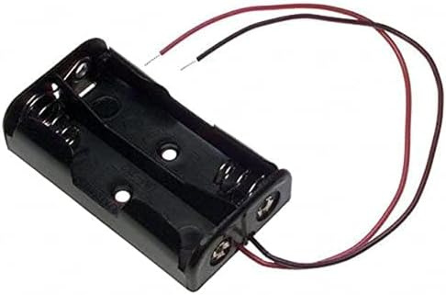
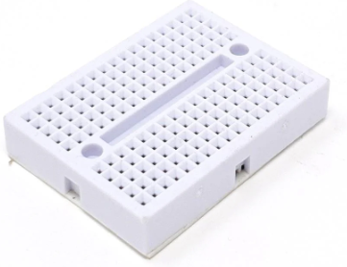
Components
Battery Holder
Breadboard
A battery holder in Arduino is a component that holds batteries and connects them to the Arduino board to provide power.
It is used for building temporary circuits. It is useful to designers because it allows components to be removed and replaced easily
Alexandria University

Slide 9
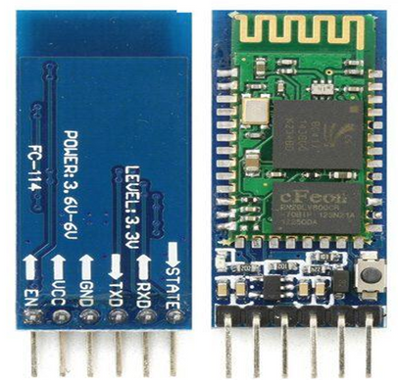
Components
Bluetooth (HC-05)
It is a basic circuit set of chip which integrated bluetooth functions and which can be used in wireless network transmission.
Alexandria University

Slide 10
Benefits
The robot can navigate through environments with obstacles without human intervention, improving efficiency and safety.
Minimizes the need for constant human control, allowing the robot to perform tasks autonomously, saving time and effort.
Auto-parking systems can park vehicles with high precision, ensuring that the vehicle is properly aligned within parking lines, which can prevent issues such as taking up two parking spaces or being too close to adjacent vehicles.
By minimizing the chances of minor accidents or scrapes during parking, auto-parking systems can help maintain the vehicle's condition and reduce repair costs.
Alexandria University

Slide 11
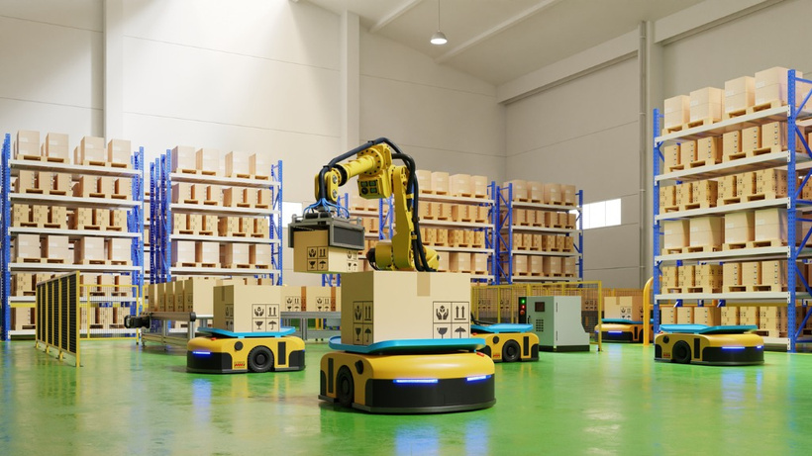
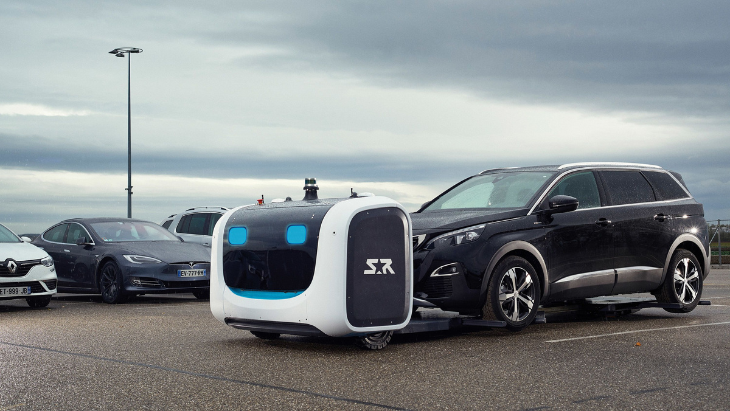
Applications
Warehouse Automation: Robots navigate warehouses to move goods, restock shelves, and fulfill orders without colliding with other robots, shelves, or workers.
Automated Valet Services: Hotels, airports, shopping malls, and other establishments can offer automated valet services where autonomous robots park and retrieve guests vehicles, providing convenience and saving time.
Alexandria University

Slide 12
Flowchart
Obstacle Avoidance
Alexandria University

Slide 13
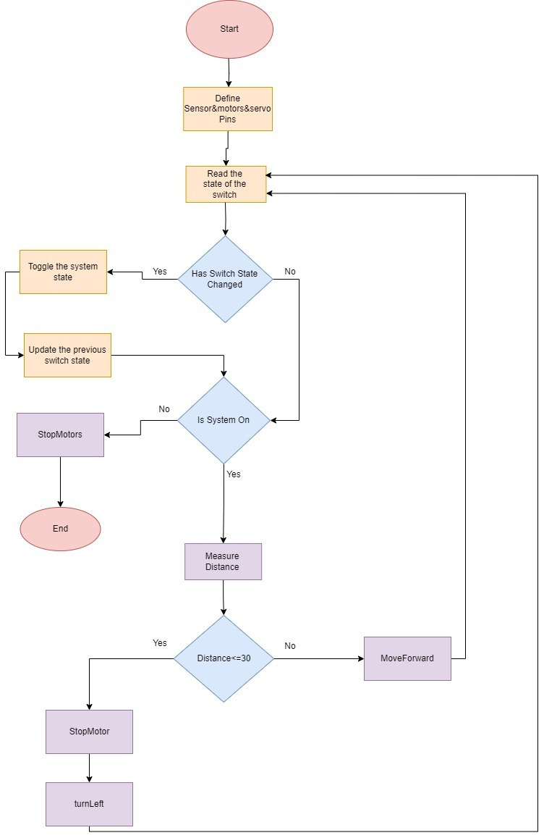

Slide 14
Flowchart
Auto-Parking
Alexandria University

Slide 15
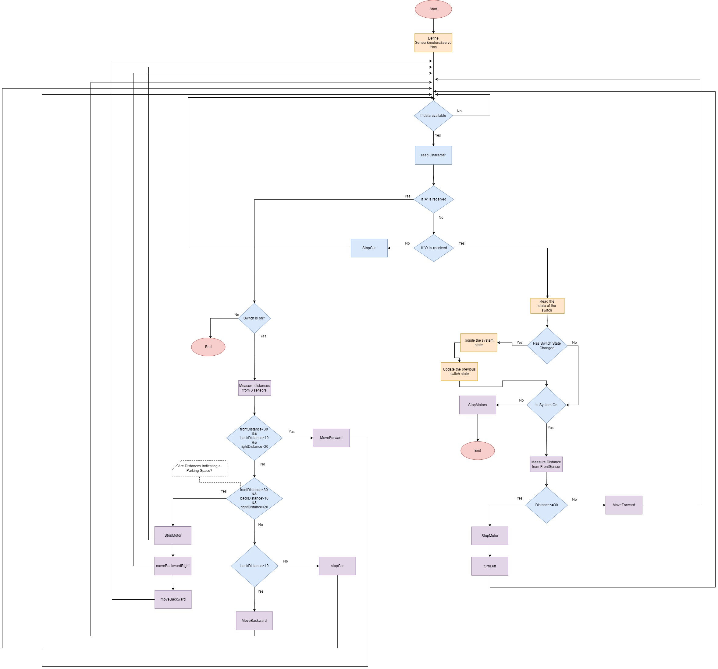

Slide 16
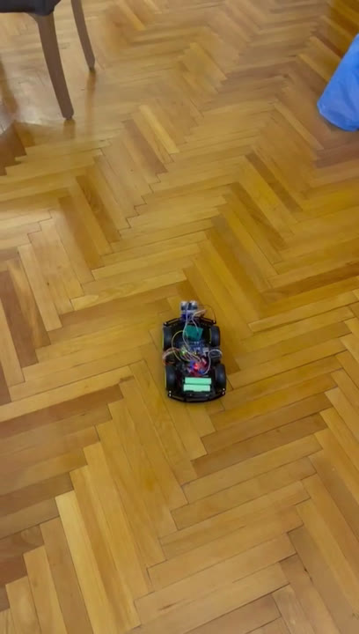
Video of Autonomous Robot with Obstacle Avoidance

Slide 17
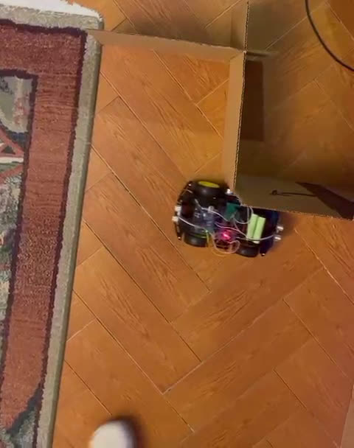
Video of Autonomous Robot with Auto-parking

Slide 18
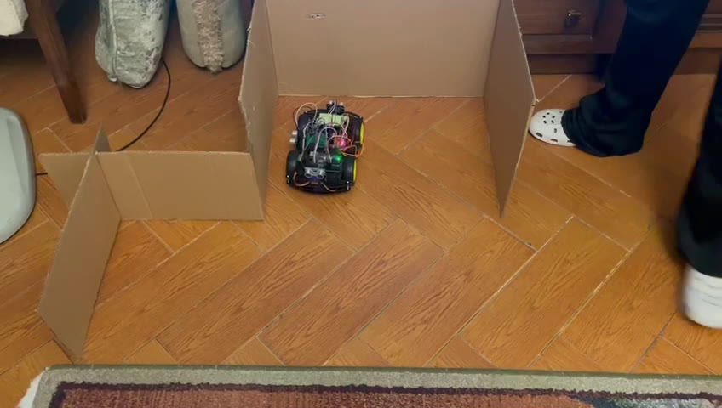
Alexandria University

Slide 19


Alexandria University

